Slide 1

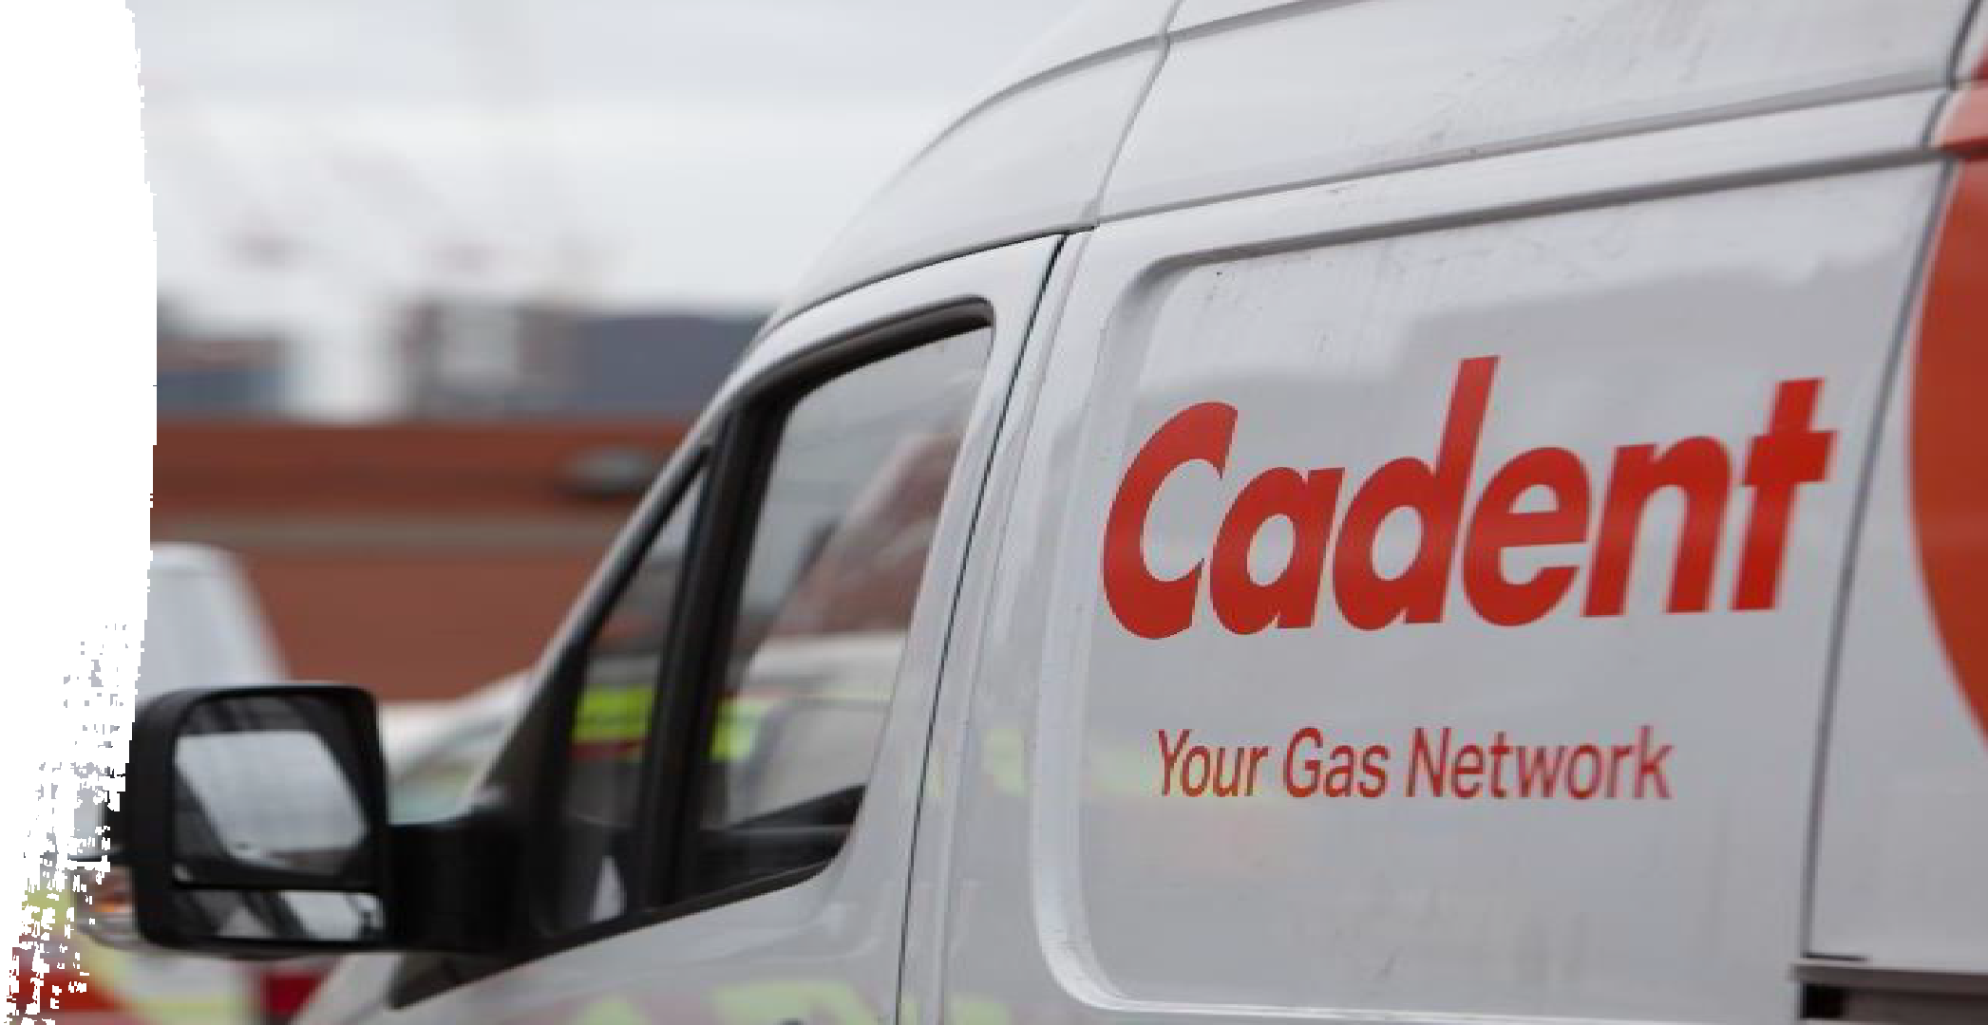

EMGA274021, Rosliston Road, Rosliston
&
EMGA274003 Coton Road Walton on Trent
26th October 2026

Slide 2
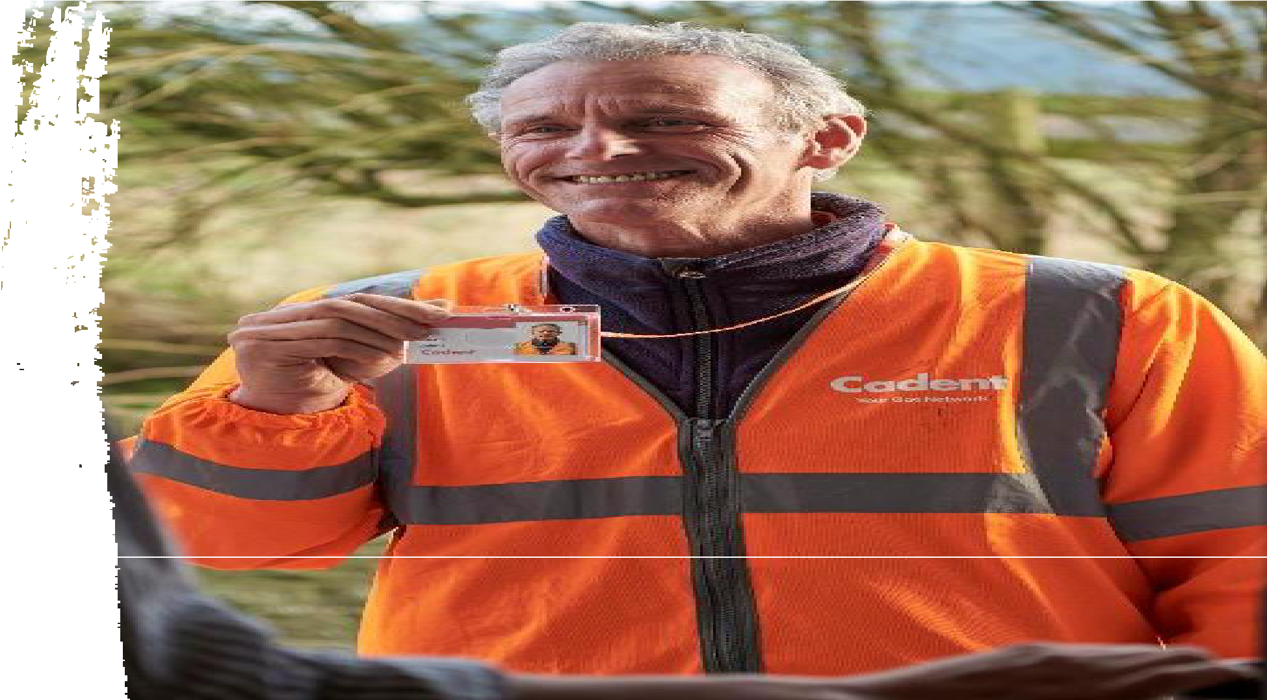

Welcome and introductions
Arnie Craven, External Affairs Manager
Richard Cashmore, Head Of Investment Delivery
Karl Stinchcombe, Customer & Stakeholder Specialists

Slide 3
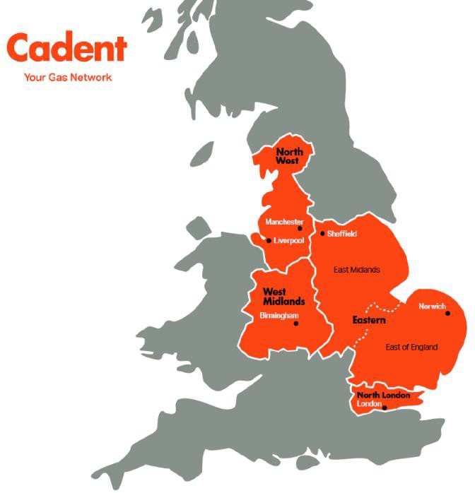











Who are Cadent?
As one of the UK’s leading gas distribution businesses, it’s our job to connect customers to the gas they use. We own and operate the gas distribution networks in the North-West, the West Midlands, East Anglia, East of England and North London.
It’s down to us to keep the energy flowing, so customers stay safe, warm and
connected.
Here are a few things we do:
manage the National Gas Emergency Service on behalf of the gas industry, 24 hours a day, 365 days a year.
transport gas to 11 million consumers through our five distribution networks
look after the pipes that bring gas to the
UK’s homes and businesses
connect new homes and businesses to the network
Types of work you might see us do…
Upgrade ageing metal gas pipes.
Repair leaking gas pipes.
And a few things we don’t:
produce gas
x own the gas that flows through our pipes
x repair gas appliances
x send out gas bills
x
Connect new homes and businesses to our network.
Cadent Gas Ltd ©

Slide 4
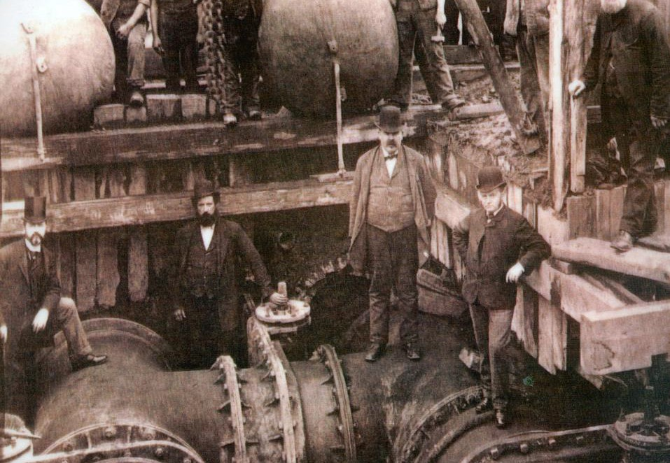


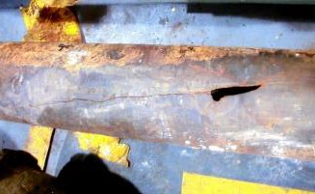
Why are we upgrading the gas pipes?
Construction in 1870’s
Ageing gas pipes today
We’re upgrading the old metal gas pipes with new more durable plastic pipes. The new pipes will help us to keep you safe and warm whilst reducing the likelihood of us having to come back to make repairs in the future.
This is government-mandated work, directed by the Health and Safety Executive (HSE), to upgrade ageing gas pipes so you and your neighbours can continue to receive a safe and reliable gas supply.
Cadent Gas Ltd ©

Slide 5
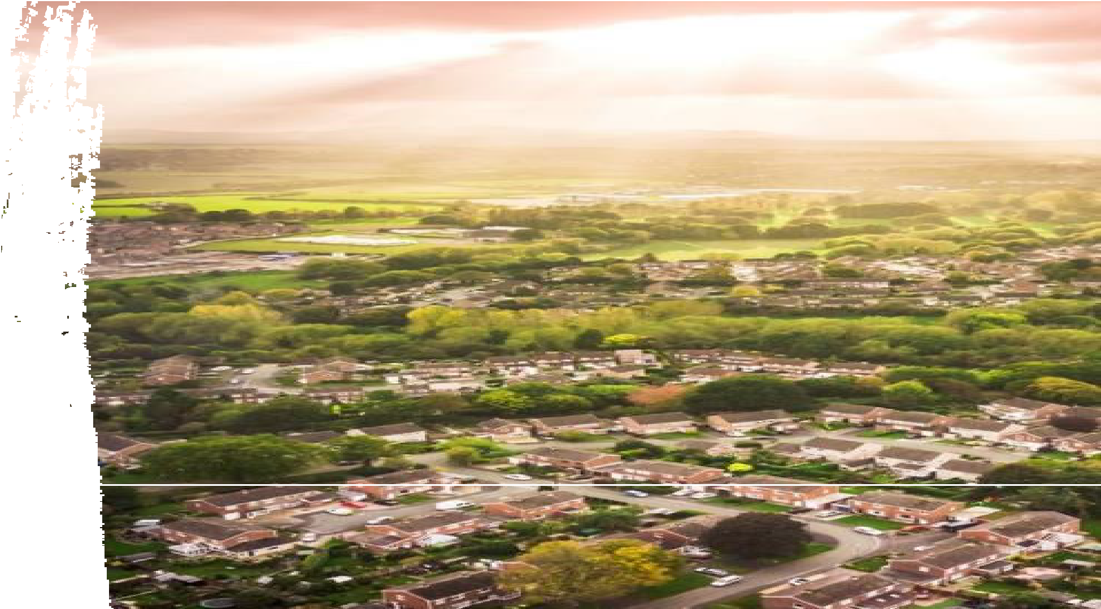
Project background
Rosliston Road, Rosliston and Coton Road Walton on Trent have 1500m of up to 6-inch cast iron gas pipes first laid in 1987 that need to be upgraded.
Over the years, there have been multiple repairs on these gas mains, resulting in extensive traffic management measures each time. These frequent repairs have significantly disrupted the highway and community.
While this project will temporarily affect the area, it is designed to eliminate the need for recurrent repairs, thereby reducing long-term traffic congestion and disruption.
Ultimately, this proactive approach will enhance the reliability of our gas network and ensure that we can keep our customers safe and warm.

Slide 6

Project summary
Start date: 26th October
Duration: Phase1: 8 Weeks Phase 2: 7 Weeks
Length of pipe to be replaced: 1500m over the two phases
Volume of gas supplies: Approx 50
Traffic management (TM): The predominate TM will be Full Road closures, with a small section of Traffic Signals.
All Rosliston Road & Coton Lane, Walton on Trent will be fully closed, due to the location of the existing gas main and the associated plant and equipment required to construct the project.

Slide 7
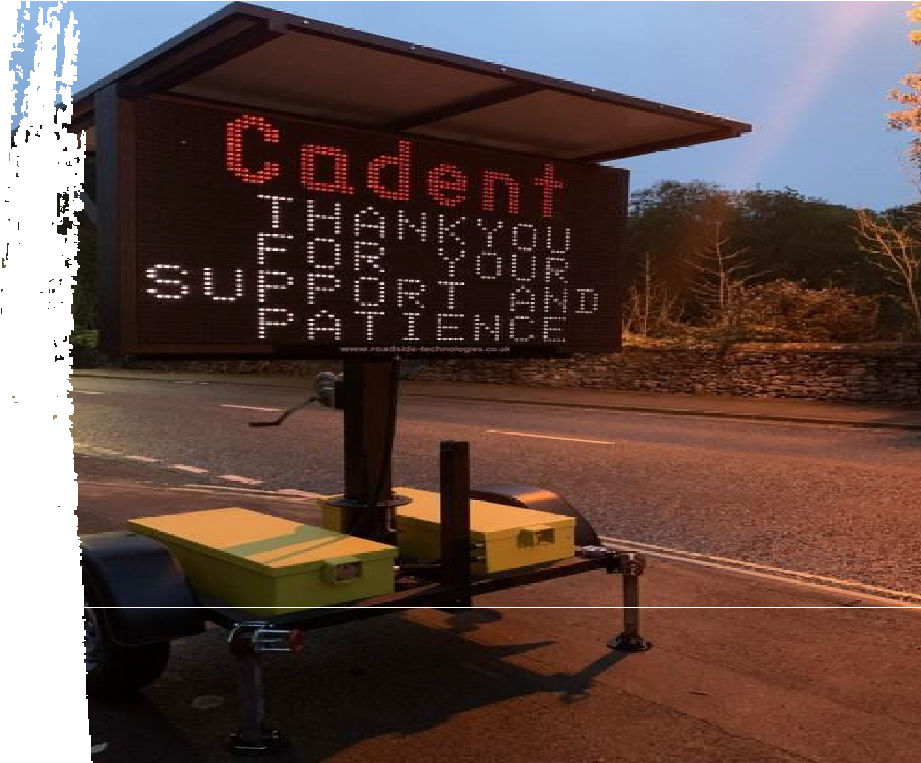
Minimising disruption
Phased approach:
Our plan is to complete these works in 2 phases, and we aim to complete approx. 150m per week there will be weeks where we don’t install any meterage and will be completing connections to our current assets.
This is providing we don’t encounter any engineering difficulties.
Local traffic impact:
Bus stops to be suspended
Road Closures will be in place 24/7 dues to open excavations, plant etc
Working hours:
Working hours of 8am- 4pm there will be days where these hours differ.
Signage will be used where the engineering activities are complete, and we are
waiting for reinstatement / concrete curing.
Public communications:
We will be communicating with customers and stakeholders to ensure that they are informed of our works and kept up to date.
Gazebo event for Phase 1 October 14th 14:00- 19:00 Venue TBC (Poster to be published and shared).
Phase 2 TBC once approval has been granted. Detail will be shared once confirmed.
We will use geotargeting, press releases, and face to face visits from Customer Liaison Officers to keep residents informed of our works.

Slide 8
Phases
Phase | Location | Traffic Management / Closures | Duration
1 EMGA274021 | Rosliston Road, Rosliston | Full Road closure | 26th October 2026 for 8 weeks (Project complete for Christmas) | The closure will be in place from the junction Burton Road This closure will affect traffic between Rosliston Road and Walton On Trent. A diversion route will be in place for the duration of the Road Closure, but drivers may expect delays.
2 EMGA274003 | Coton Road, Walton on Trent | Full Road Closure | ‘Subject to permit approval and potential collaboration with neighbouring authority’ | Rosliston Road up to the junction with Coton Road Full Road Closure Coton Road up to Main Street Full Road Closure Station Lane up to the River Trent Full Road Closure – Access to be maintained Main Road Junction of Station Road and Coton Lane. There will be a Road Closure on Station Lane and Coton Lane with 2-way lights on Main Street

Slide 9
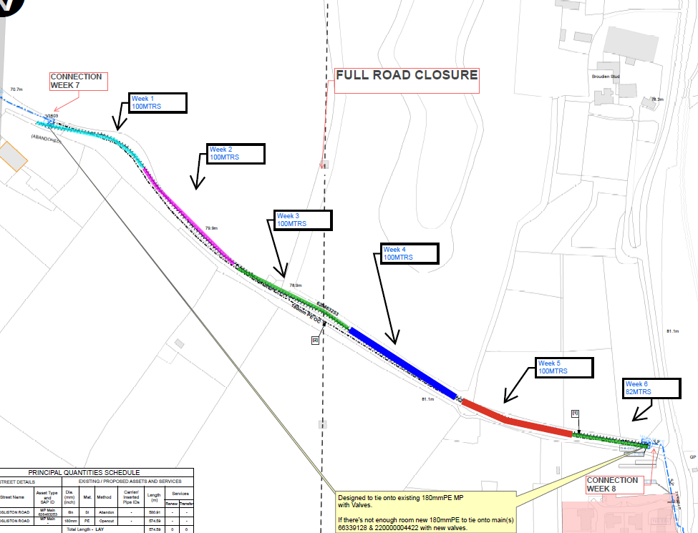
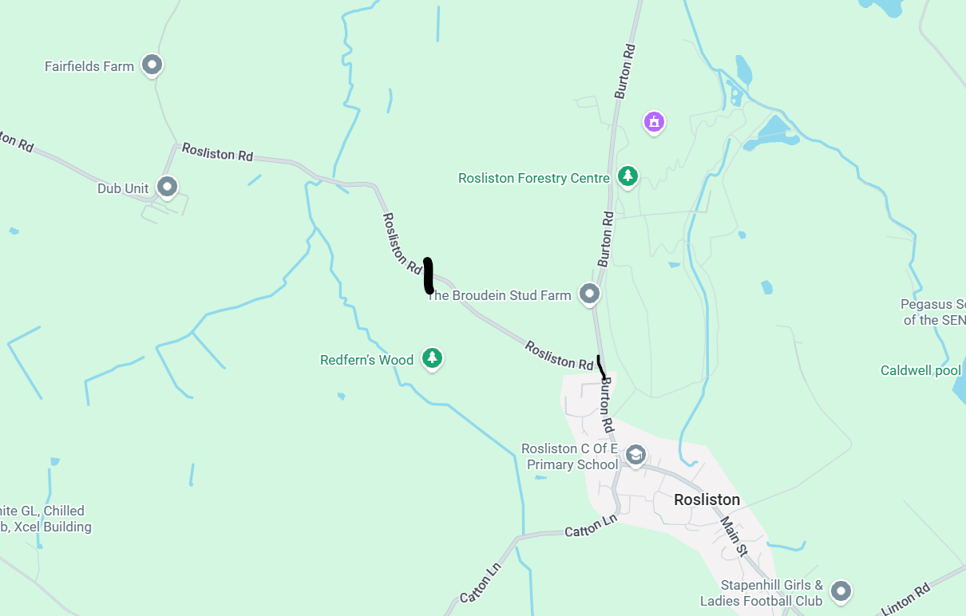
EMGA274021, Rosliston Road, Rosliston.
Works location for
phase 1
Works Site

Slide 10
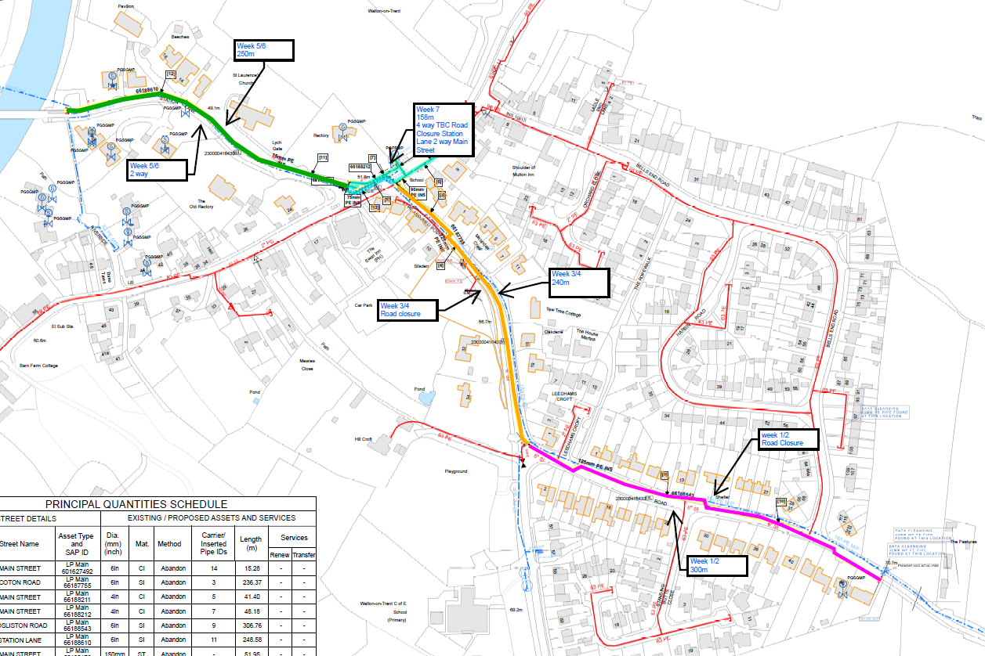
Phase 2 EMGA274003 Coton Road Walton on Trent

Slide 11

Q&A
We want to work with you, but how can we make sure this happens most effectively?
How can we work with you to see these works delivered effectively?
How would you prefer to be kept updated?
12

Slide 12


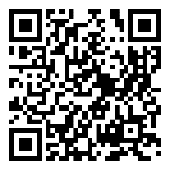


Where can you find out more?
Got a question?
Call us on 0800 090 3071 (Monday – Friday from 8am to 8pm)
@
Email us at CustomerCareEM@cadentgas.com
Scan the QR code to send us a question[change Qrcode]

